Slide 1
Together, we will Create Buildings that Regenerate our Planet .

Slide 2
Regeneros Ltd.
1 School Lane, Bonby, DN200pp,
United Kingdom
UK: + 447948045510 ,
ranyams@regeneros.org
www.regeneros.org
Contents
03/
Client Base and Projects
01/
Executive Summary
04/
Corporate Information &
02/
Services & Offerings

Slide 3
1. Introduction
2. Services
2.1 Green Building Certification Consultations
2.2 WELL Certification Consultations
2.3 Net Zero and Carbon Management
2.4 Waste Management
2.5 Circular Economy
2.6 Sustainable Design Frameworks and
Legislation /Modern Methods of Construction
2.7 Higher Education and Research
3.Client Base & Reference Projects
4.Corporate Information and Resumes

Slide 4
1-Introduction
Regeneros’ ethos and mission is to create a built environment that regenerates the planet, whilst simultaneously promoting the health and wellbeing of occupants and aligning with our customers’ core business objectives.
The United Nations’ had reported as early as 2018 stating that a 2 °C temperature increase would essentially lead to climate change conditions that would seriously affect humanity’s living conditions including extreme weather, rising sea levels, flooding and others . Limiting global warming to 1.5 °C compared with 2 °C would reduce these climate change impacts to manageable levels.
The other key finding was that meeting a 1.5 °C (2.7 °F) target is possible but would require "deep emissions reductions" and "rapid, far-reaching and unprecedented changes in all aspects of society”. In line with this, the shift from traditional approaches to more progressive ones based not only on sustainability , but on regeneration is critical to maintaining a planetary environment that the human species can survive and thrive in. Regeneros partners with business leaders across the globe to successfully incorporate regenerative strategies into their businesses.

Slide 5
At a regional and national level, most nations have duly incorporated sustainability into their future vision, with many including the UK targeting a carbon neutral economy by 2050. Despite these commitments, 2020 tied with 2016 as the hottest year on record , and United Nations’ research shows that global investment in fossil fuels continues to be substantially higher than investment in climate change technologies including renewables. So the question is : how can we work together to close this gap ?
Headquartered in the United Kingdom and with operations worldwide, Regeneros believes in a pathway to a sustainable future that considers human wellbeing and business finances. To be applied successfully in the real world, sustainability initiatives must be undertaken with a global mindset that considers the unique conditions and challenges of each business and location. It’s also critical that we utilize and develop critical technological enablers such as Artificial Intelligence. By 2035, correct utilization of AI alone can result in 2.4 Gigatons of reductions in greenhouse gas emissions. You can learn more about AI in sustainable construction and Regeneros’ approach in our Modern Methods of Construction section.
We are grateful and proud of the faith our customers have placed in us and the results we have taken in partnership with them to date to protect our planet’s future and human health and wellbeing in the built environment.
We thank you for your commitment to a sustainable future, and for considering Regeneros as your partner on this journey .
Ranya Metwalli Shields ,
USGBC Faculty, LEED AP BD+C, CEM, WELL AP.
Managing Director , Regeneros Ltd

Slide 6
02-
Services & Offerings

Slide 8
2.1 Green Building Certification Consultations
Internationally recognized Green Building Rating systems such as LEED, BREEAM provide standardized, transparent, and objective assessments of your building’s green credentials and a tangible, highly visible showcase of your businesses sustainability credentials and commitment to a better future to your customers, employees and market.
Leading green building certifications such as LEED , provide well defined criteria for sustainability in the built environment , aiming to create buildings that regenerate the planet, promote human health and well-being, and aim to do so in a flexible, project-specific manner that aligns with business objectives. LEED evaluates a building's environmental performance in areas such as energy efficiency, water conservation, indoor environmental quality, and sustainable site development.

Slide 9
Regneros has worked with stakeholders across the supply chain of the built environment including architects, owners and contractors across the globe to successfully achieve various green building certifications. Key to our clients’ success in achieving Green Building Certification was Regeneros’ bespoke and holistic approach, which duly considered commercial and business specific constraints as well as sustainability objectives. We have worked with clients to create compliance pathways that are specific to their businesses, geographies, markets and even the preferences of their external customer base.
Regeneros looks to understand and work with our customers to address the different challenges faced by customers in different market segments and geographies in achieving sustainability objectives. Regeneros has worked with clients to overcome challenges such as: limited waste management infrastructure in their location, assistance in sourcing and identifying building products and materials with sustainable attributes in their local markets, incorporating sustainable design objectives into limited construction budgets , incorporating sustainability strategies into awareness programs that met marketing objectives/ needs of external customers and many, many more.

Slide 10
LEED Consultations.
At Regeneros, we work closely with clients to guide them through the entire LEED certification process, from initial assessment to final certification. Our services include:
• LEED feasibility / gap assessment: For existing buildings, we conduct a comprehensive assessment of a building's existing systems and operations to determine its potential for LEED certification and identify any necessary upgrades or improvements.
• LEED documentation management: We focus on clarifying and communicating clearly to the GBCI via our custom narratives and ensuring documentation provided is clear, consistent and sufficient. We help clients navigate the complex documentation requirements of LEED certification, ensuring that all necessary documentation is completed accurately and on time.
• LEED energy modeling: We use advanced energy modeling software to simulate a building's energy use and identify opportunities for energy savings and efficiency improvements.
• Sustainable site development: We provide expertise in sustainable site design and development, including stormwater management, landscaping, and green infrastructure.
• Indoor environmental quality: We help clients optimize indoor environmental quality through strategies such as ventilation, lighting, and materials selection.

Slide 11
2.2 WELL Certification Consultations

Slide 12
The WELL Building Standard is the world’s first performance-based rating system that measures and certifies buildings' impact on human health and wellbeing. It was developed by the International WELL Building Institute (IWBI).
The WELL Building Standard takes a holistic approach to building design, construction, and operations, and covers ten categories or concepts are they are referred to in WELL that impact human health: air, water, nourishment, light, movement, thermal comfort, sound, mind and community . Each category includes specific features and strategies that buildings can implement to improve occupants' health and wellbeing.
Regeneros’ team includes highly qualified WELL Accredited Professionals who can not only work with you to achieve the highest standards of health and wellbeing, but can also help you capitalize on synergies between WELL and other rating systems focused on environmental performance such as LEED or BREEAM.

Slide 13
Some of the Green Building Certification Systems we cover
And many others .....
.

Slide 14
2.3 Net Zero, Energy & Carbon Management

Slide 15
Effective Energy and Carbon Management is critical for businesses looking not only to promote a sustainable future , but also to address immediate operational issues and rising costs. In the UK and Europe, energy prices have increased sharply .In other parts of the world such as the Middle East, major economies such as Saudi and Kuwait have declared future visions based on economies that are much less reliant / not dependant on fossil fuels. In the UK, the drive for Net Zero by 2050 means that Energy Auditing now goes hand in hand with Carbon Management, considering not only your overall consumption but the carbon footprint related to your fuel types .

Slide 17
Our services include energy audits, energy efficiency assessments, energy procurement, carbon management , creation and guidance on Net Zero roadmaps and renewable energy solutions. We can also help businesses comply with relevant regulations and standards, such as ESOS, ISO 50001, and SECR. We also provide guidance to projects looking to attain LEED Zero.
Regeneros’ team includes highly qualified Energy Managers accredited by the Association of Energy Engineers, USA.

Slide 18
2.4 Waste Management

Slide 19
We work with businesses during all stages of operations to manage waste sustainably in line with their local regulations and requirement and the US EPA’s waste management hierarchy.
From an environmental perspective, construction is an inherently polluting activity. Our approach to waste management is progressive and starts with source reduction , ie minimizing the amount of waste generated. Strategies include promoting the use of prefabrication , reduced packaging and many of the other techniques promoted in LEED v4.1 and the Modern Methods of Construction .

Slide 20
We also understand that recycling infrastructure can vary greatly from one location to another, and we work with your business to assess the options available locally and provide you with the most effective waste management pathways.
We can also perform in depth audit stream analyses of your waste streams for existing buildings and understand your business to create viable projections for your new construction projects and building based on our experience and industry analyses.

Slide 21
2.5
2

Slide 22
Circular economy principles are centred on maximizing the lifecycle of a product and reducing or eliminating materials being sent to landfill and minimizing the use and extraction of raw materials and greenhouse gas emissions to create new products. Instead, circular economy promotes a “cradle to cradle” approach as opposed to the more traditional cradle to grave. In a cradle to cradle approach ,instead of being discarded after use/ sent to landfill, materials and products are kept in use through repair, refurbishment, recycling , or other means of recovery, creating a closed-loop system where waste is reduced, and resources are kept in use.
In a circular economy, materials and products are designed from the outset at the product development phase to be reused, repaired, or recycled. Product design criteria focuses on aspects such as elimination of unnecessary packaging, intensive design engineering to reduce the amount of raw materials used, and prioritizing the selection of rapidly renewable and recyclable materials. Waste is also minimized through practices such as waste prevention, reuse, and recycling throughout the product’s lifecycle to ensure it remains in circulation.

Slide 23
Circular economy practices can be applied across all sectors of the economy, from manufacturing and construction to consumer goods and services. The principles can also be applied not only at product level but at building, corporate and even national levels. By adopting circular economy principles, businesses can reduce their environmental impact, increase their resource efficiency, and achieve cost savings, while contributing to a more sustainable and resilient economy.

Slide 24
Regeneros' Services Include:
Circular business models: We help companies to explore and implement circular business models, such as product-as-a-service, leasing, and sharing, which can create new revenue streams and reduce environmental impact.
Circular economy strategy development: We help companies to develop a comprehensive circular economy strategy that is aligned with their business goals and objectives.
Product design and innovation: We help companies to design and develop products that are more durable, repairable, and recyclable, and that have a lower environmental impact. We consider strategies for lowering embodied carbon, increasing the utilization of recycled and recyclable materials in the design.
Supply chain optimization: We work with companies to optimize their supply chains to reduce waste, increase efficiency, and improve environmental performance.

Slide 25
2.6 Sustainable Design Frameworks and Modern Methods of Construction

Slide 26
The Modern Methods of Construction (MMC) is an umbrella term used in the United Kingdom to describe a range of innovative, sustainable construction techniques that differ from traditional site-based construction. Whilst this framework was formulated in the UK, the strategies covered therein are applicable to a wide variety of markets, and many are synergistic with Green Building Rating systems such as LEED and BREEAM.
The UK government has identified increased utilization of the MMC as a key enabler to simultaneously fulfil a number of socio-economic objectives outlined in UK policy including:
- Addressing the UK’s current country's housing shortage by promoting MMC strategies that reduce construction times, without impacting quality of build.
- Promoting the use of sustainable design and construction strategies that reduce the environmental impact of the built environment and align construction activities in the UK with the government's vision for a market-led, technology- driven transition to decarbonise the UK economy and reach net zero by 2050.
- Increasing the efficiency, speed, and quality of the construction industry.

Slide 27
The Modern Methods of Construction is divided into seven categories. The first five categories cover a number of off site manufacturing methods, and categories 6-7 cover modern improvements which are site based, including measures such as the use of robotics and drones.

Slide 28
Examples of Stategies promoted in the Modern Methods of Construction
1. | Off-site manufacturing (OSM): This involves manufacturing building components or entire modules off-site in a factory-controlled environment, then transporting them to the construction site for assembly. Examples of OSM include prefabricated building components, flat-pack homes, and fully assembled modules.
2. | Modular construction: This involves building structures by assembling prefabricated modules in a factory, which are then transported to the construction site for assembly. Modular construction is particularly suited to multi-story buildings, such as apartments and student accommodation.
3. | Use of Artificial Intelligence and other technological advances in Construction : examples include the use of exoskeletons, Virtual Reality, Augmented Reality, drones, robotic workers and others.

Slide 29
Regeneros' Services Include:
MMC strategy development: We work with clients to develop a comprehensive strategy for adopting MMC that meets their specific needs and requirements. Our strategies are tailored to each client's goals and objectives, and are based on our deep knowledge and experience of MMC.
MMC procurement support: We support clients in the procurement of MMC components and systems, including identifying suitable suppliers and contractors, negotiating contracts, and managing the supply chain.
MMC design and engineering: We work with architectural and engineering firms and contractors to incorporate MMC strategies at the applicable stages of design and construction.
MMC training and education: We offer training and education services to clients and their employees on the principles and practices of MMC, as well as its benefits and challenges

Slide 30
2.7 Higher Education and Research

Slide 31
Regeneros in Higher Education
Regeneros partners with higher education institutions in the United Kingdom and abroad to promote awareness and to educate University Level Students and equip them for Green Careers.
Regeneros existing partnerships and services provided to Higher Education include
but are not limited to :
Blending theoretical knowledge of sustainability with practical, real life experiences to develop the next generation of Sustainability Leaders . Sample offerings include LEED Lab, where University Students are taught theoretical concepts of sustainable design , and apply the same principles by utilising their campus as a live LEED project .
Guest Speaker on the subject of Sustainability in the Built Environment
Development of University Level Courses on topics related to Sustainability in the Built Environment.
Partnership in research and development as relates to carbon management and sustainability.
Education both online and in-person on sustainability for architects and engineers ( Ranya Metwalli Shields’ courses are featured on the United States Green Building Council official education website. )

Slide 32
2.1 Green Building Certification Consultations
03-
Client Base & Reference Projects

Slide 33
References include projects executed by Regeneros' Managing Director before Regeneros was founded .
Photos used referenced from Architectural Firm's websites

Slide 34
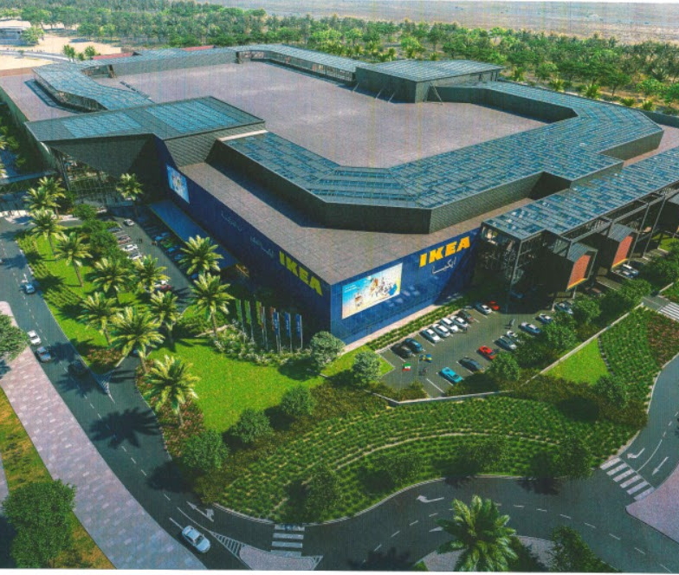
IKEA II , Sabahiya Mall
Location : Sabahiya, Kuwait
Project Sustainability Requirments: LEED v4 ID+C , Retail
Regeneros Scope : LEED Consultancy Services (Design Phase)
LEED Construction Administration Services (Construction)
Features : LEED Certified Commercial Kitchen, Innovative composting techniques in line with retail environment , equivalency assessments for local and regional products against ENERGY STAR requirements, and many others

Slide 35
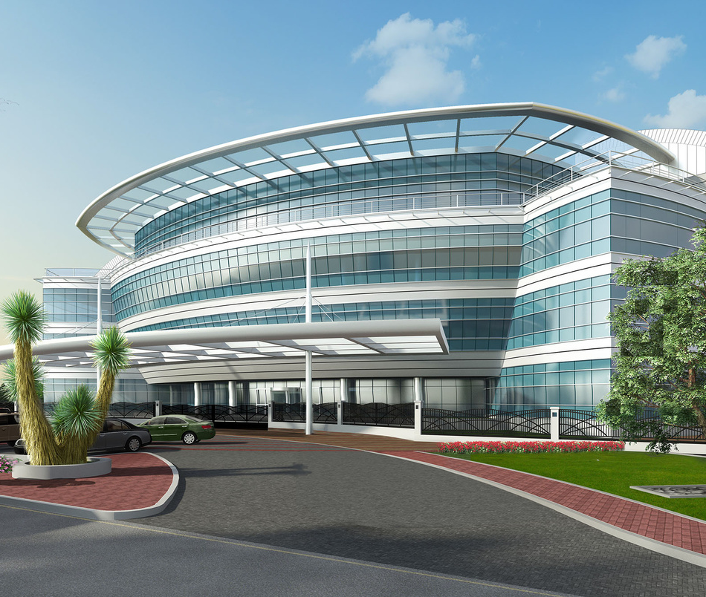
Equate Petrochemicals New Headquarters
Location : Ahmadi, Kuwait
Project Sustainability Requirements: LEED BD+C Silver
Regeneros Scope : LEED Main Contractor Representative
Features : Was one of the first projects in Kuwait to successfully adopt LEED Sustainable Construction practices including : selection of low emitting materials, construction waste management and many others

Slide 36
Kuwait Gulf Oil Company New Headquarters
Location : Ahmadi, Kuwait
Project Sustainability Requirements: LEED BD+C Silver
Regeneros Scope : LEED Main Contractor Representative
Features : successfully adopt LEED Sustainable Construction practices including : selection of low emitting materials, construction waste management and many others

Slide 37
Kuwait Oil Company Exhibition Hall, Abdaliyah
Location : Abdaliyah, Kuwait
Project Sustainability Requirements: LEED BD+C Silver
Scope : LEED Design Coordination, High Level Risk assessments for Security and Fire in line with KOC requirements.
Features : Blended sustainability requirements with award winning architecture in a preserved area.

Slide 38
Zero Waste Scotland Programme,
Scotland, United Kingdom
Location : Scotland , United Kingdom
Project Sustainability Requirements: Energy Auditing & Carbon Management
Scope : Review of over 200 Energy Audits performed in Scotland .
This project was initially funded by the European Union and was then followed by the Scottish government after Brexit.
The project provided SMEs in Scotland with EU funded Energy and Carbon Audits, followed by government grants to assist with carbon management .
Regeneros reviewed the Energy and Carbon audits in terms of technical content, auditing methodologies, verification of carbon factors and emissions calculations, as well as overall project management and quality requirements.

Slide 39
Regional Energy Audits- North Lincolnshire County,
England, United Kingdom
Location : England , United Kingdom
Project Sustainability Requirements: Energy Auditing & Carbon Management
Scope : Energy Audits for SMEs throughout North Lincolnshire County.
Status : Ongoing
This is a public contract funded by the UK Shared Prosperity Fund.
In line with the UK’s Net Zero objectives and Levelling Up agenda, Regeneros was selected by the British Government ( North Lincolnshire Council) the to provide Energy Auditing and Carbon Management Services to SMEs in the Region.

Slide 40
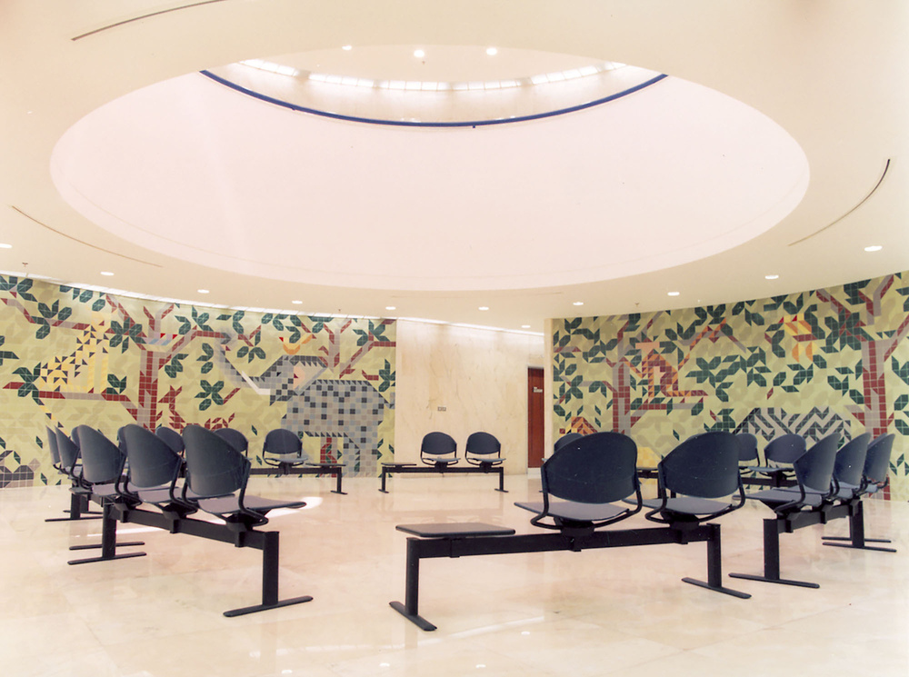
NBK Children’s Hospital , Kuwait
Location : Sabah Hospitals Complex, Kuwait
Project Sustainability Requirements: LEED v4 BD+C Healthcare
Regeneros Scope : LEED Consultancy Services (Design Phase)
LEED Construction Administration Services (Construction)
Features : LEED Gold Certification
Status : Ongoing.

Slide 41
04-
Corporate Information

Slide 42
Address : 1 School Lane, Bonby, DN200pp , North Lincolnshire, U.K.
T: +44 (0)7958045510
Email: ranyams@regeneros.org

